Slide 1
Intelligent Enterprise Assistant: Enhancing Organizational Efficiency through AI-driven Chatbot Integration
CSE7101- Capstone Project
Review-1
Batch Number:CBD_1
Under the Supervision of,
Dr./Mr./Ms./Prof. Pakruddin B
Professor / Associate Professor / Assistant Professor
School of Computer Science and Engineering
Presidency University
Roll Number | Student Name
20221CBD0037 20221CBD0010 20221CBD0054 | PRAVEEN R KUSHAL V MAHESH BABU P
Name of the Program: CBD-Computer Science & Technology (Big Data)
Name of the HoD: Dr. Pravinthraja S
Name of the Program Project Coordinator: Dr. H M Manjula
Name of the School Project Coordinators: Dr. Sampath A K , Dr. Geetha A

Slide 2
Problem Statement Number: PSCS_336
Organization: GAIL, Ministry of Petroleum and Natural Gas
Category (Hardware / Software / Both) :Software
Problem Description: Develop a chatbot using deep learning and natural language processing techniques to accurately understand and respond to queries from employees of a large public sector organization. The chatbot should be capable of handling diverse questions related to HR policies, IT support, company events, and other organizational matters. (Hackathon students/teams to use publicly available sample information for HR Policy, IT Support, etc. available on internet.) Develop document processing capabilities for the chatbot to analyse and extract information from documents uploaded by employees. This includes summarizing a document or extracting text (keyword information) from documents relevant to organizational needs. (Hackathon students/teams can use any 8 to 10 page document for demonstration). Ensure the chatbot architecture is scalable to handle minimum 5 users parallelly. This includes optimizing response time (Response Time should not exceed 5 seconds for any query unless there is a technical issue like connectivity, etc.) Enable 2FA (2 Factor Authentication – email id type) in the chatbot for enhancing the security level of the chatbot. Chatbot should filter bad language as per system-maintained dictionary. Youtube Link/Video Link (3 Minute video explaining the Problem Statement): https://youtu.be/Q3pP7mRk5Qk NOTE: GAIL (INDIA) LTD will not provide any hardware, software, license, data or any other resource to SIH hackathon Teams. The teams should use free and/or open-source resources, as applicable, for the entire project.

Slide 3
Content
Problem Statement
Objectives
Background and Related work for title Selection
Analysis of Problem Statement
Innovation or Novel Contributions
Git-hub Link
Timeline of the Project
References

Slide 4
Problem Statement
In large public sector organizations, employees often face challenges in quickly accessing accurate information related to HR policies, IT support, company events, and other organizational matters. Traditional query resolution methods involve multiple communication layers, leading to delays, reduced productivity, and employee dissatisfaction. Additionally, processing organizational documents for extracting important information or summaries is time-consuming and manual. There is a need for an AI-driven, scalable, and secure chatbot that can interact naturally with employees, process uploaded documents, and provide quick, accurate responses all while ensuring security, content filtering, and optimal performance.

Slide 5
Objectives
Design and Develop an AI-driven Chatbot using deep learning and NLP to handle diverse organizational
queries efficiently.
Integrate Document Processing capabilities for extracting keywords and generating summaries
from uploaded documents.
Implement a Scalable Architecture capable of handling at least 5 concurrent users with a response time of
under 5 seconds.
Ensure Security with 2FA (Email-based Authentication) to protect user accounts.
Enable Offensive Language Filtering using a system-maintained bad word dictionary.
Create an Intuitive Web-based UI using HTML, CSS, and JavaScript for seamless user interaction.
Leverage Open-Source Tools and APIs to minimize cost and ensure compatibility with the hackathon’s
constraints.

Slide 6
Background and Related work
Background
In today’s fast-paced organizational environments, efficient access to information is critical to maintaining productivity. Public sector organizations, in particular, often face bottlenecks in communication due to hierarchical structures and manual information retrieval processes.
AI-driven chatbots have emerged as a transformative solution by leveraging Natural Language Processing (NLP) and Machine Learning (ML) to understand user queries and deliver instant, context-aware responses. Such systems can also process and summarize documents, ensuring employees have quick access to relevant information without navigating multiple portals.
Advancements in cloud-based AI services, open-source NLP libraries, and web-based integration have made it possible to develop intelligent assistants that can be deployed quickly, scaled easily, and customized for specific domains such as HR, IT support, and policy queries.

Slide 7
Background and Related work(contd...)
Related Work
IBM Watson Assistant – Offers enterprise-grade chatbot solutions capable of handling complex queries but requires high subscription costs, making it less accessible for budget-constrained public sector organizations.
Google Dialogflow – Provides NLP-based chatbot frameworks but often relies heavily on predefined intents and may need custom enhancements for document processing and multi-domain handling.
Microsoft Bot Framework – Supports AI integration with enterprise tools but requires substantial setup and infrastructure.
Open-source Chatbots (e.g., Rasa, Botpress) – Allow for customization and domain-specific training, but require significant development effort for advanced features like document summarization and bad word filtering.

Slide 8
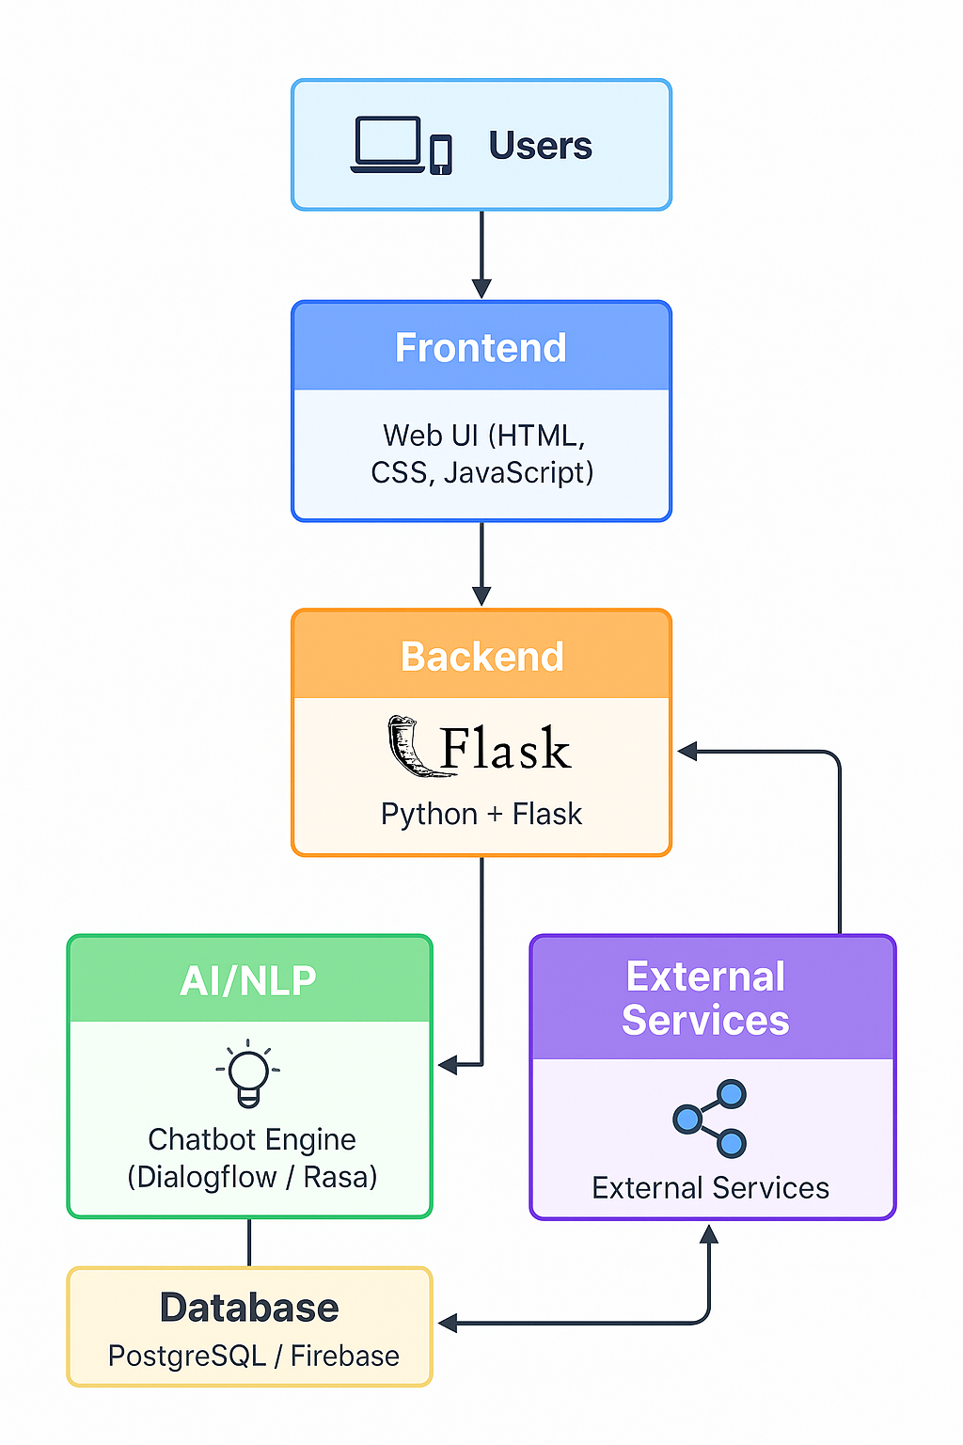
Architecture

Slide 9
Analysis of Problem Statement
1. Background
In large organizations, employees often struggle to quickly access information such as HR policies, IT support procedures, company events, and other organizational resources. Traditional methods (emails, manuals, or calling support desks) are:
Time-consuming
Prone to delays
Inconsistent in answers
2. Current Challenges
Information is scattered across multiple platforms (HR portal, IT ticket system, notice boards, etc.).
Manual support from HR/IT teams causes delays, especially for repetitive queries.
Lack of 24/7 availability for answering employee questions.
Low efficiency in searching long policy documents.
Limited personalization — every employee receives the same general answer, regardless of role or department.

Slide 10
Analysis of Problem Statement (contd...)
3. Need for a Solution
An AI-powered chatbot can:
Provide instant, consistent, and accurate responses to common queries.
Integrate with external services (HR databases, IT support APIs, etc.).
Work 24/7 without extra manpower.
Offer multilingual support if needed.
Reduce workload on HR and IT departments.
4. Scope of the Problem
The problem is not just technical but also organizational:
Employees waste productive hours searching for information.
HR/IT staff spend too much time on repetitive, simple queries instead of important tasks.
Company onboarding and training are slowed down due to inefficient information access.

Slide 11
Analysis of Problem Statement (contd...)
5. Proposed Approach
Develop a Flask-based chatbot integrated with NLP for understanding queries.
Connect with external services like HR policy APIs, IT ticketing systems, and event calendars.
Build a user-friendly interface for easy interaction.
Include search and document processing capabilities.

Slide 12
Innovation or Novel Contributions
AI-powered Document Understanding : Integration of custom document parser with semantic embeddings
to enable deep contextual search beyond keyword matching.
Multi-layer Security with 2FA:Backend authentication enhanced with Two-Factor Authentication ensuring
secure access to sensitive data.
Real-time Summarization with Profanity Filtering : Novel combination of on-the-fly summarization with
context-aware profanity detection for maintaining professional responses.
Unified Chat UI with Embedded AI Services : Seamless integration of chat interface, AI summarizer,
and doc search in a single interactive platform.
Customizable Workflow Gantt Tracking : Built-in project tracking feature with Gantt visualization to help
users monitor development progress.
Scalable Architecture : Backend design using Flask + modular AI microservices for easy scaling and future
feature expansion.

Slide 13
Github Link
The Github link provided should have public access permission.
Github Link : https://github.com/praveen29L

Slide 14
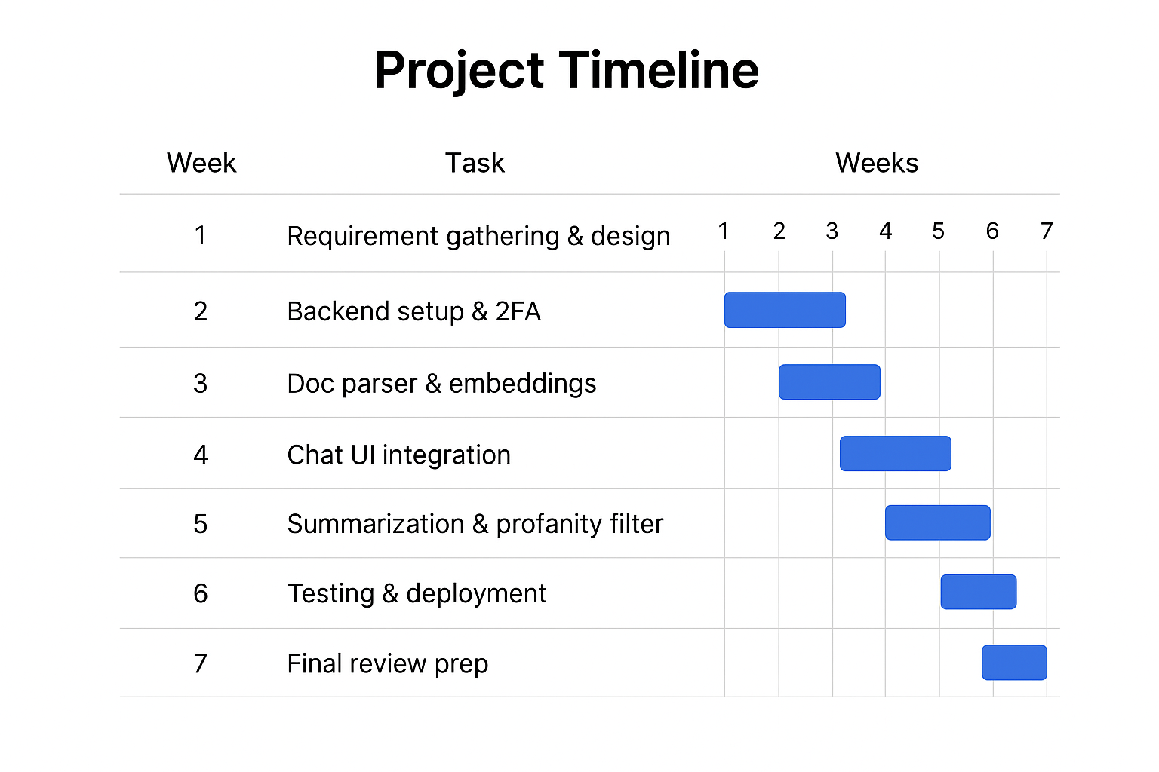
Timeline of the Project (Gantt Chart)

Slide 15
References (IEEE Paper format)
[1] S. Gupta, A. Sharma, and M. Kumar, "An Intelligent Chatbot for Document-Based Query Answering," in 2021 IEEE International Conference on AI, pp. 45–50, 2021.
[2] Microsoft, “Azure Bot Service Documentation,” 2024. [Online]. Available: https://learn.microsoft.com/azure/bot-service

Slide 16


